Slide 1

Git & GitHub Short Notes For DevOps Engineers
By Harshit Sahu

Slide 2

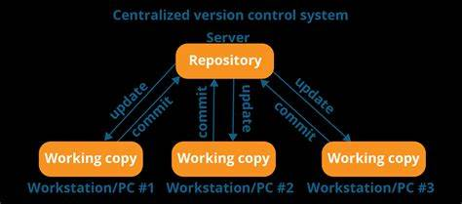
Git & GitHub Short Notes
Before diving into Git and GitHub we've to know some basic terminologies.
There is a term Source Code Management, and it has two types:-
CVCS-Centralized Version Control System
DVCS-Distributed Version Control System
📌Note:
It is not locally available, meaning we've always needed to be connected to a network to perform any action.
Since everything is centralized, if the central server fails, you will lose the entire data

Slide 3
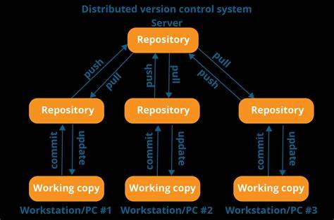
DVCS-Distributed Version Control System
📌 Note:
In DVCS, every contributor has a local copy or 'clone' of the main repository. Everyone maintains a local repository of their own, which contains all the files and metadata in the main repository.
♾️Why do we need Source Code Management as a DevOps Engineer?
To use the CICD pipeline in DevOps, you must have the most recent project updates. Because DevOps monitors the most recent code and creates definitions that execute a variety of tasks by user needs, the release definitions that assist in deploying the most recent binaries on your primary environment also use these definitions. Any end server where the finished product is made ready for usage might be your client’s computer, the production environment, or both.

Slide 4
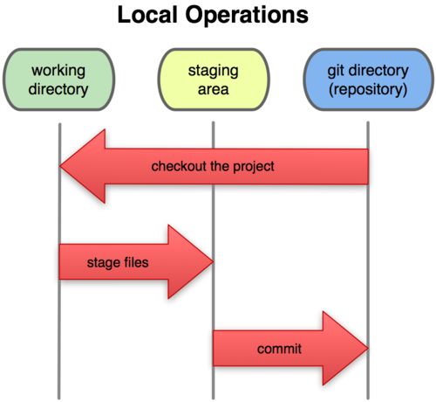
📌 Important Terms:
🔗Repository –
A repository is a place where you have all your codes or kind of folder on the server.
It is a kind of folder related to one product.
Changes are personal to that repository.
🔗 Server –
It stores all repositories.
It contains metadata also
🔗 Working Directory –
Where you see physically and do the modifications.
At a time, you can work on a particular branch.
🔗 Commit –
Store changes in the repository. You will get one Commit ID.
It is 40 Alpha-Numeric characters.
It uses the SHAI checksum concept.
Even if you change one dot, the Commit ID will change.
Commit is also named the SHA-1 hash.
Git Three-Stage Architecture

Slide 5
🔗Commit ID/ Version ID/ Version –
Reference to identify each change.
To identify who changed the file.
🔗 Tags –
Tags assign a meaningful name with a specific version in the repository. Once a tag is created for a particular save, even if you create a new commit, it will not be updated.
🔗 Snapshots–
Represents some data of a particular time.
It is always incremental i.e.; it stores the change (append date) only. Not the entire copy.
🔗 Push –
Push operations copy changes from a local repository server to a remote or central repository. This is used to store the changes permanently in the git repository.
📌 Git Important Terms
🔗 Pull –
Pull operation copies the changes from a remote repository to a local machine. The pull operation is used for synchronization between the repository.

Slide 6
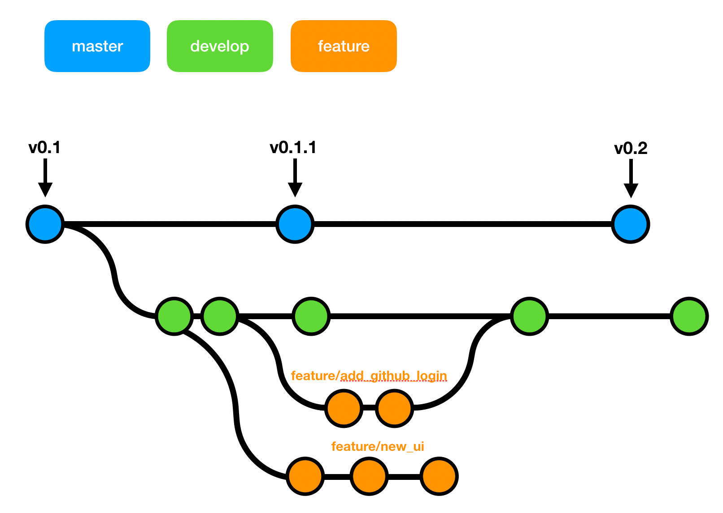
All About Git Branch
The product is the same, so one repository but a different task.
Each task has one separate branch.
Finally merges(codes) all branches.
Changes are present in that branch.
The default branch is ‘Master’.
The file created in the workspace will be visible in any of the branch workspaces until you commit, once you commit then that file belongs to that branch.
After being done with the code, merge other branches with ‘Master’.
This concept is useful for parallel development.
You can create any number of branches.
When a new branch is created, data from the existing is copied to the new branch.

Slide 7
Commands for Branch
🚀 To show all branches
git branch
🚀 Create a new branch
git branch <branch_name>
🚀 For going to a specific branch/Change branch
git checkout <branch_name>
🚀 Delete a branch
git branch –d <branch_name>
🚀 Command for branch merge
We can’t merge branches of different branches
We use the pulling mechanism to merge branches.
git merge <branch_name>

Slide 8
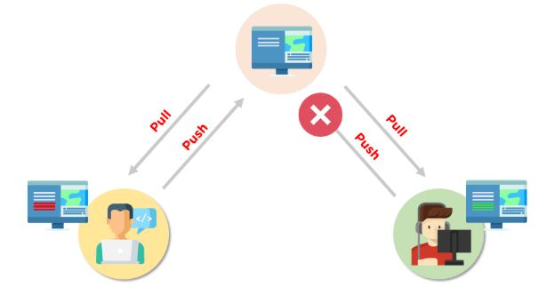
Conflicts in Git and how to
Resolve it
When the same file has different content in different branches, if you do merge, conflict occurs (Resolve conflict then add and commit)
How Do You Fix Conflicts When Merging in Git?
The procedures required to resolve merge conflicts in Git might be shortened by taking a few specific actions.
Opening the conflicting file and making the appropriate adjustments is the simplest approach to remedy the issue.
After making changes to the file, we may stage the newly merged material using the git add command.
The git commit command is used to generate a new commit as the last step.
To complete the merging, Git will generate a new merge commit.

Slide 9
Git Command to resolve the
Conflict
🚀 The ‘git log --merge’ command helps to produce the list of commits that are causing the conflict
git log merge
🚀 The ‘git diff’ command helps to identify the differences between the state’s repositories or files
git diff
🚀 The ‘git checkout’ command is used to undo the changes made to the file, or for changing branches
git checkout
🚀The ‘git reset --mixed’ command is used to undo the changes to the working directory and staging area
git reset mixed
🚀 The ‘git merge --abort’ command helps in exiting the merge process and returning to the state before the merging began
git merge abort
🚀The ‘git reset’ command is used at the time of merge conflicts to reset the conflicted files to their original state
git reset

Slide 10
Basic Git Command
🚀 Set global username and email for Git (locally)
git config –global user.name “<your username>”
git config --global user.email “<your email>”
🚀 Initialise an empty Git Repository
git init
🚀 Clone an existing Git Repository
git clone <repository_url>
🚀 Add file/stage to git
git add <filename>
🚀 Add all the current directory files to git
git add .
🚀 Commit all the staged files to git
git commit -m “<your_commit_message>”
🚀Restore the file from being modified to Tracked
git restore <filename>
git checkout <filename>
🚀Show the status of your git repository
git status
🚀Show the branches of your git repository
git branch
🚀 Checkout to a new branch
git checkout -b <branch name>
🚀 Checkout to an existing branch
git checkout <branch name>

Slide 11
Basic Git Command
🚀 Remove a branch from Git
git branch –d <branch name>
🚀 Show remote origin URL
git remote -v
🚀 Add remote origin URL
git remote add origin <your_remote_git_url>
🚀 Remove remote origin URL
git remote remove origin
🚀 Fetch all the remotes branches
git fetch
🚀 Push your local changes to the remote branch
git push origin <branch_name>
🚀Pull your remote changes to the local branch
git pull origin <branch_name>
🚀Check your git commits and log
git log
📌You can also check my Git Repository for more detailed commands:
DevOps-Tools-Notes/Git at main · harshitsahu2311/DevOps-Tools-Notes (github.com)

Slide 12
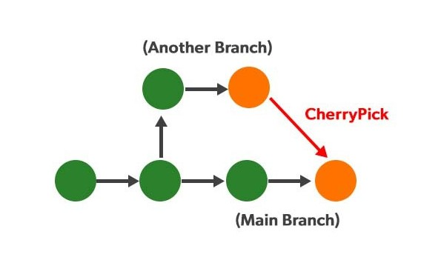
Cherry Picking in Git
Cherry picking is picking a commit from a branch and applying it to another. Git cheery-pick can be useful for undoing changes. For example, say a commit is accidentally made to the wrong branch. You can switch to the correct branch and cherry-pick the commit to where it should belong.
Git Stash and pop
Generally, the stash means “store something safely in a hidden place.” Suppose you’re implementing a new feature for your product. Your choice is in progress and suddenly a customer escalation comes because of this, you must keep aside your new feature work for a few hours. You cannot commit your partial code or throw away your changes. So, you need some temporary storage to store your partial changes and later commit them.

Slide 13
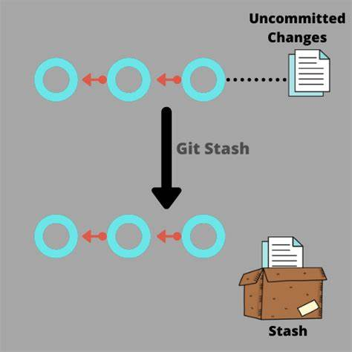
Git Stash & Pop
Command for Stashing:
🚀 To Stash an item
git stash
🚀 To see stashed items list
git stash list
🚀 To apply stashed items
git stash apply stash@{<list_number>}
🚀 To clear the stash items
git stash clear
🚀 Git Stash Pop (Reapplying Stashed Changes)
Git allows the user to re-apply the previous commits by using the git stash pop command. The popping option removes the changes from the stash and applies them to your working file.
🚀 Poping an item from the stash
git stash pop

Slide 14
Git Stash & Pop
Git Stash Drop (Unstash)
The git stash drop command is used to delete a stash from the queue. Generally, it deletes the most recent stash.
git stash drop
What is git rebase?
Rebasing is the process of moving or combining a sequence of commits to a new base commit. Rebasing is most useful and easily visualized in the context of a feature branching workflow. The primary reason for rebasing is to maintain a linear project history.
Git Stash Drop (Unstash)
Git rebase <base>

Slide 15
What is git squash?
To “squash” in Git means to combine multiple commits into one. You can do this at any point in time (by using Git’s “Interactive Rebase” feature), though it is most often done when merging branches.
How to Squash Your Commits
There are different ways and tools when it comes to squashing commits. In this post, we’ll talk about Interactive Rebase and Merge as the two main ways to squash commits.
Step 1: Check the commit history
To check the commit history, run the below command:
git log --online
Step 2: Choose the commits to squash.
Suppose we want to squash the last commits. To squash commits, run the below command:
git rebase -i HEAD ~3
The above command will open your default text editor and will squash the last commits.
Step 3: update the commits
On pressing enter key, a new window of the text editor will be opened to confirm the commit. We can edit the commit message on this screen.

Slide 16
Thank you for Reading
Please share your feedback !!

